Slide 1
Lesson 6
Review + Final Project

Slide 2
Agenda
Review
Best Practices
Tips
Project
Time to create!

Slide 3
Common HTML Tags
Common tags: <div>, <span>, <header>, <footer>, <nav>, <section>, <article>, <p>, <h1> - <h6>, <a>, <img>, <ul>, <li>, <form>, <input>, etc.
Lists, input, text formatting
Semantic HTML
Attributes: class, id, src, href, alt, title, style, etc.
Images, Links

Slide 4
Common CSS Properties and Selectors
Properties: color, background-color, font-size, margin, padding, border, width, height, display, position, float, clear, etc.
Selectors: element selectors, class selectors, id selectors, descendant selectors, pseudo-classes, pseudo-elements.

Slide 5
Important Concepts
Block and Inline elements
Inline, internal and external CSS
The CSS Hierarchy
Box Model
Flexbox
Media Queries
Pseudo-classes (e.g. for <a>)
Pseudo-elements
Transitions & Animations

Slide 6
Best Practices

Slide 7
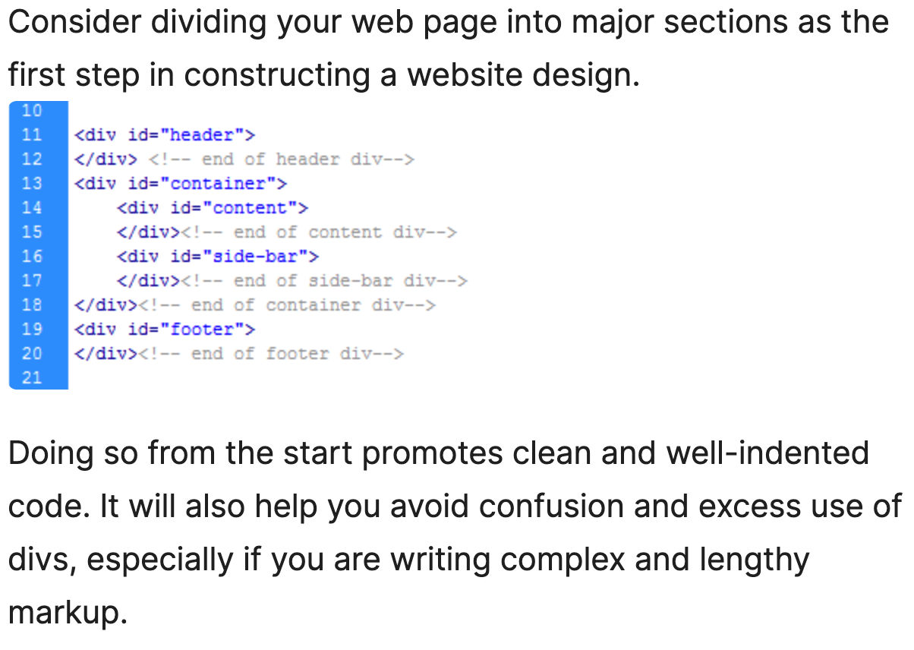
Use Divs to Divide Layouts into Major Sections
Separate Content from Presentation
Try to go for external CSS usually
Try to avoid internal/inline

Slide 8
Group Similar Elements
Group related styles together.
Use comments to separate different sections of the stylesheet.
Follow a consistent naming convention for classes and IDs.

Slide 9
Writing Clean and Semantic HTML
Consistency
Use appropriate tags for content: <header>, <footer>, <nav>, <article>, <section>.
Ensure HTML is well-structured and easy to read.
Maintain consistent spacing, font sizes, and colors across the site.
Use a limited color palette and stick to it. (try www.coolors.co)
Ensure that the site's design is cohesive.

Slide 10
Tips

Slide 11
Basic Principles
Alignment: Ensure elements are properly aligned.
Proximity: Group related items together.
Contrast: Use contrasting colors to make important elements stand out.
Repetition: Repeat design elements to create a cohesive look.
Navigation: Make your site fluid and easy to navigate.

Slide 12
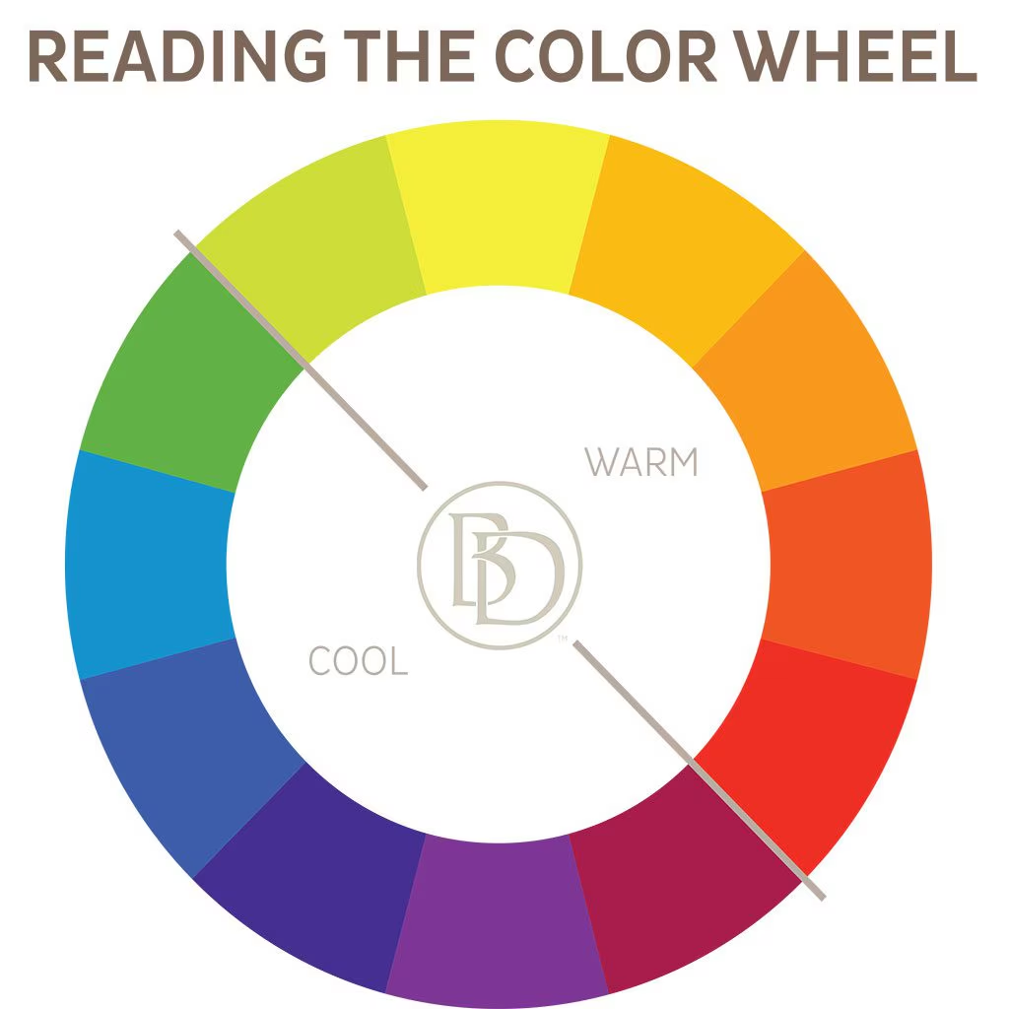
Color Theory:
See what looks best for your site.
Complementary Colors: Colors opposite each other on the color wheel.
Analogous Colors: Colors next to each other on the color wheel.

Slide 13
Typography
Choosing Fonts: Select fonts that are easy to read and match the site's theme.
Font Pairing: Use a maximum of two or three different fonts that complement each other.
Readability: Ensure text is easy to read with appropriate font size, line height, and contrast.
https://fonts.google.com/

Slide 14
Project

Slide 15
Personal Website
If you don’t want to create a personal website, you can try a website explaining a topic or a website about another person/character.
Instructions Navbar
Wireframing, Examples
Wireframe on paper (or on Figma)

Slide 16
Next steps after this course
Practice, practice, practice!
Don’t forget what you learned
Exercise your new skills often and create a new project every month or two
Learn JavaScript
Learn back-end
Use JavaScript to give your web page functionality and logic
Learn more on responsive design
Learn front-end frameworks and libraries, e.g. React, Vue.js

Slide 17
Thanks & Happy Hacking!

